Slide 1


Slide 2


Slide 3
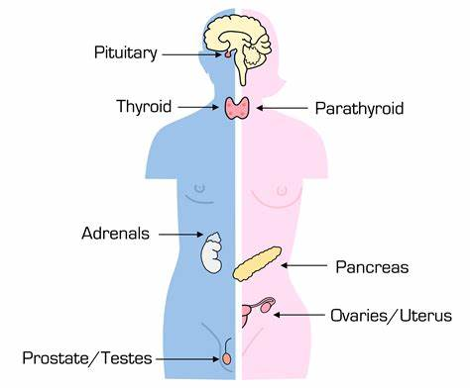

Slide 4
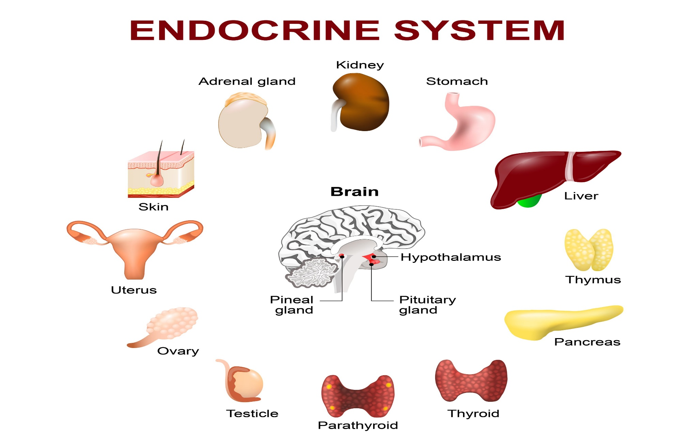
AGE RELATED CHANGES IN ENDOCRINE SYSTEM
Prepared by:
Bandana Tiwari
Roll no: 6
BNS 2nd year

Slide 5
General Objectives
At the end of the classroom session , BNS 1st year students will be able to explain about age related changes in endocrine system and Hyperthyroidism.

Slide 6
Specific Objectives
At the end of this teaching session, the BNS 1st year will be able to :
explain the age related physiological changes in endocrine system
define hyperthyroidism
list the causes of hyperthyroidism
enlist the sign and symptoms of hyperthyroidism

Slide 7
Cont..
enlist the diagnostic investigation of hyperthyroidism
explain the treatment of hyperthyroidism
explain the nursing management of hyperthyroidism
list the complication of hyperthyroidism

Slide 8

AGE RELATED CHANGES IN ENDOCRINE SYSTEM

Slide 9
1) PITUITARY GLANDS
The pituitary gland decreases in volume approximately 20% in older persons.
The pituitary gland produces less growth hormone, which leads to decrease in muscles mass.
Decreases are seen in ACTH, TSH, FSH, LH.

Slide 10
2) THYROID GLANDS
With age, the thyroid gland progressively atrophies.
Decrease basal metabolic rate.
Reduce iodine uptake.
Less secretion and release of thyrotropin.

Slide 11
Cont..
Secretion of thyroid-stimulating hormone (TSH) and the serum concentration of thyroxine (T4) do not change, although there is a significant reduction in triiodothyronine (T3), believe to be result of the reduce conversion of T4 TO T3.

Slide 12
3) ADRENAL GLANDS
Much of the secretary activity of the adrenal cortex is regulated by adrenocorticotropic hormone (ACTH), a pituitary hormone.
As ACTH secretion decreases with age, secretory activity of the adrenal gland also decreases.

Slide 13
Cont..
Aldosterone levels are 30% lower in adults age 70 to 80 years old than in younger adults this may cause orthostatic hypotension.
Cortisol is a stress response hormone that has anti-inflammatory and anti-allergy effects. Secretion of cortisol diminishes by 25% with aging.

Slide 14
4) OVARIES AND TESTES
Gonadal secretion declines with age, including in testosterone, estrogen and progesterone.
Diminish in estrogen may lead two metabolic effects; coronary thrombosis, osteoporosis.
Decrease in size of the ovaries.

Slide 15
5) PANCREAS
There is delayed and insufficient release of insulin by beta cells of pancreas in older people.
Decrease tissue sensitivity to circulating insulin result in hyperglycemia.
Receptor sensitivity to glucose declines.

Slide 16
COMMON HEALTH PROBLEMS OF ELDERLY IN ENDOCRINE SYSTEM
HYPERTHYRODISM
HYPOTHYRODISM
DIABETES MELLITUS

Slide 17
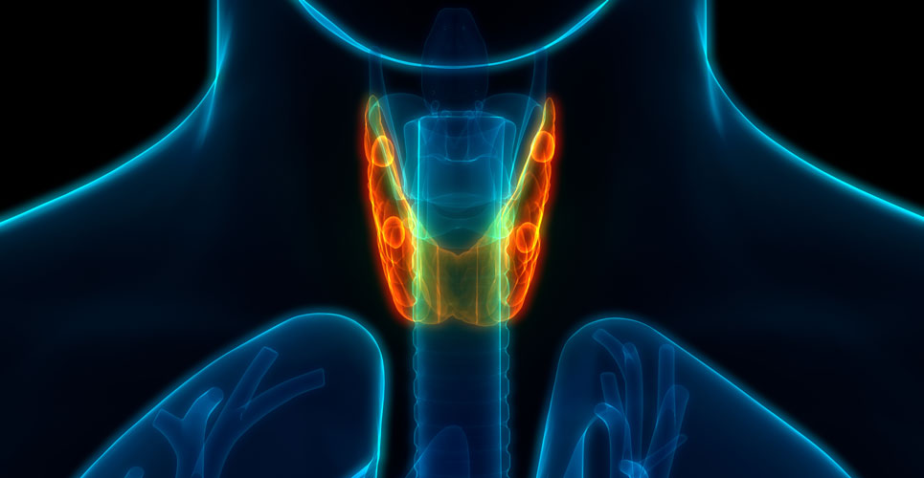
HYPERTHYRODIDISM

Slide 18

HYPERTHYROIDISM

Slide 19
INTRODUCTION
Hyperthyroidism, a common endocrine disorder, is a form of thyrotoxicosis resulting from an excessive synthesis and secretion of endogenous or exogenous thyroid hormones by the thyroid gland. (Bahn, Burch, Cooper, Etal,2011)
It is the second most prevalent endocrine disorder after diabetes mellitus.

Slide 20
Cont..
This disease is common in old age and 20% of all thyrotoxicosis patients are aged 60 years or more.
Women are at a much higher risk of developing thyrotoxicosis than men.

Slide 21
CAUSES
Graves’ disease
Functioning adenoma and toxic multinodular goiter
Excessive intake of thyroid hormones
Abnormal secretion of TSH

Slide 22
Cont..
Thyroiditis
Excessive iodine intake

Slide 23
COMMON SIGNS AND SYMPTOMS
Insomnia
Hands tremors
Nervousness
Heat intolerance
Increase bowel movements

Slide 24
Cont..
Losing weight despite normal or increased appetite
Excessive sweating
Joints pains
Light or absent menstrual periods

Slide 25
Cont..
Difficulty concentrating
Eyes seem to be enlarging

Slide 26
DIAGNOSTIC INVESTIGATIONS
History taking
Physical examination
Thyroids stimulating hormone (TSH)assay
Thyroxine (T4) radioimmunoassay.

Slide 27
Cont..
Tri-iodothyronine(T3) radioimmunoassay.
Electrocardiogram
Other test-radioactive iodine uptake; thyroid autoantibodies; antithyroglobulin

Slide 28
MANAGEMENT
1)MEDICAL MANAGEMENT:
Antithyroid medication
Drugs that inhibit hormone function .
Thioamides : Methimazole

Slide 29
Cont..
Drugs to control peripheral manifestation of hyperthyroidism
Propranolol
Glucocorticoids

Slide 30
2)SURGICAL MANAGEMENT:
Thyroidectomy performed in younger clients for whom drugs therapy has not been effective.
3)Radioactive iodine therapy

Slide 31
NURSING MANAGEMENT
Assessment
Obtain a health history , including family history of hyperthyroidism and symptoms medications etc.
History of weight loss, diarrhoea , insomnia , emotional liability , palpitation .
Eyes for exophthalmos, photophobia .

Slide 32
Cont…
Neck palpitation for enlarged thyroid gland.
Perform multi system assessment that include cardiac respiratory , neurologic and GI system .
Evaluate nutrition status , emotional state and psychological status.

Slide 33
Nursing Diagnosis
Imbalances nutrition less than body requirement related to hypermetabolic state and fluid loss through diaphoresis.
Activity intolerance related to exhaustion secondary to increase metabolic rate.
Ineffective coping related to irritability , hyper excitability , emotional instability.

Slide 34
Cont..
Anxiety related to concern about surgery/ radioactive treatment.
Risk for impaired skin integrity related to diaphoresis , hyperpyrexia , restlessness and repaid weight loss.

Slide 35
NURSING INTERVENTION
1) Monitor and record patient’s vital signs, weight, fluid intake, and urine output.
2) Measure neck circumference daily to check for progression of thyroid enlargement.
3) Evaluate serum electrolyte level, and check for hyperglycemia and glycosuria.

Slide 36
Cont..
4) Assess the patient for signs of heart failure.
5) Administer antithyroid medications as ordered.
6) If iodine is part of the treatment, mix it with milk, juice, or water to prevent gastrointestinal distress, and give it through a straw to prevent tooth discoloration.
7) Provide a cool environment

Slide 37
Cont..
8) Observe for and prevent complications (exophthalmos, thyroid storm)
9) Consult a dietician to ensure a nutritious diet with adequate calories and fluids.
10) Stress the importance of regular medical follow up after discharge.

Slide 38
COMPLICATION
Grave’s eye disease
Grave’s dermopathy and acropachy
Underactive thyroid (hypothyroidism)
Thyroid storm

Slide 39
Cont..
Osteoporosis
Pregnancy problems
Heart related problems

Slide 40


Slide 41


Slide 42
POST TEST
True or false
Hyperthyroidism is caused by abnormal secretion of TSH .
(True)
Hyperthyroidism decrease bowel movement .
(False)

Slide 43
Fill in the blanks
The complication of hyperthyroidism is…
Grave’s eye disease
Myxedema

Slide 44
ASSIGNMENT
Write the physiological changes of aging in endocrine system.
What do you understand about hyperthyroidism . Write the nursing management of it .

Slide 45
PLAN FOR NEXT CLASS
We will discuss about hypothyroidism and physiological changes in genitourinary system .

Slide 46
REFERENCES
Baral, R. Essential of Geriatric Nursing. Makalu publication.
Bruners and Siddharth, Medical Surgical Nursing, 10th edition.
Pradhan . M,K and Roka, A,T. (2015). Gerontological Nursing for BN/BSN Students (1st edition) Vidyarthi Prakashan
Subedi, P,S and Subba, K,H.(2019). A Textbook of Geriatric Nursing.(1st edition ). National Book Center.

Slide 47
Shrestha , H. (2072) . A Textbook of Medical Surgical Nursing 1 and 2 .(revised edition ). Heritage publishers and distributors Pvt . Ltd .
Timalsina, R. (2077). Comprehensive Textbook of Geriatric Nursing.(3rd ed). Samiksha publication.

Slide 48


